Slide 1
Improving the Flood-it! App
Module 11 Challenge

Slide 2
Who are the current Flood-It! users?
What behaviors do users exhibit in the game? Areas to examine include:
Growth
Engagement
Stickiness
Retention
Are there different user segments who behave differently on the app?
If so, what are the key segments to examine? How do they differ?
How have users and their behavior changed over time?
Where do engagement issues exist?
What KPIs do you recommend tracking to measure and assess the health of the app in the future?
What opportunities do you see to change the game to improve users’ gaming experience?
What qualitative research do you propose to follow up on the data you analyzed?
Instructions

Slide 3
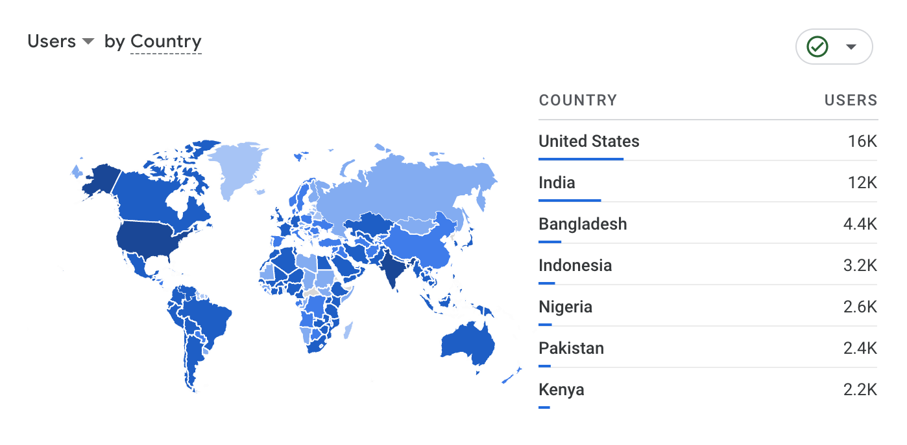
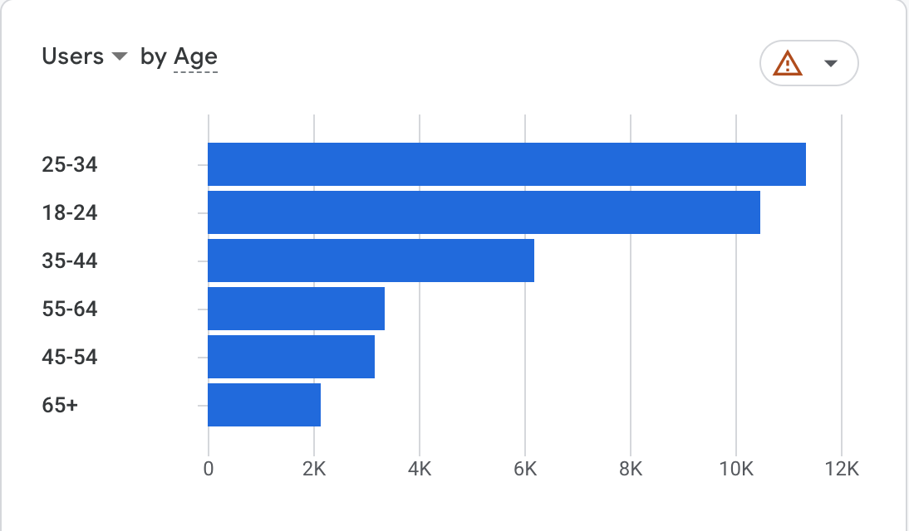
Who are the current Flood-It! users?
Most of the users come from USA (25%), India (19%), and Bangladesh (7%) between the ages of 18-24, 25-34

Slide 4
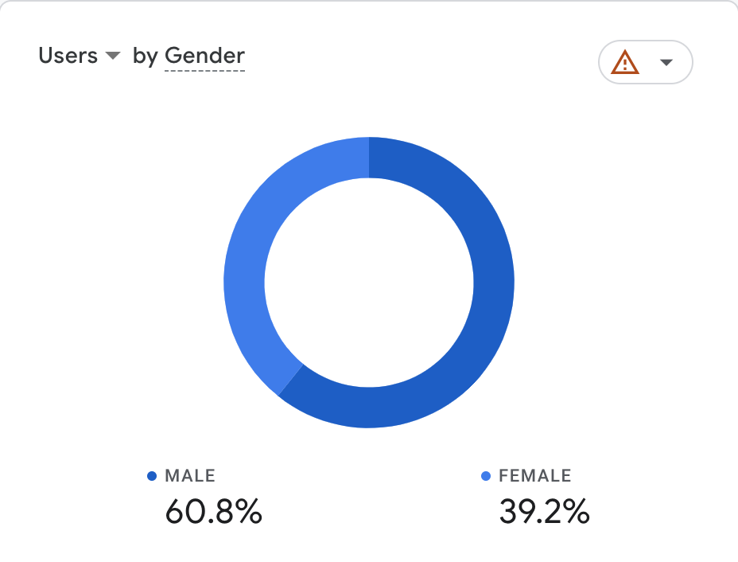
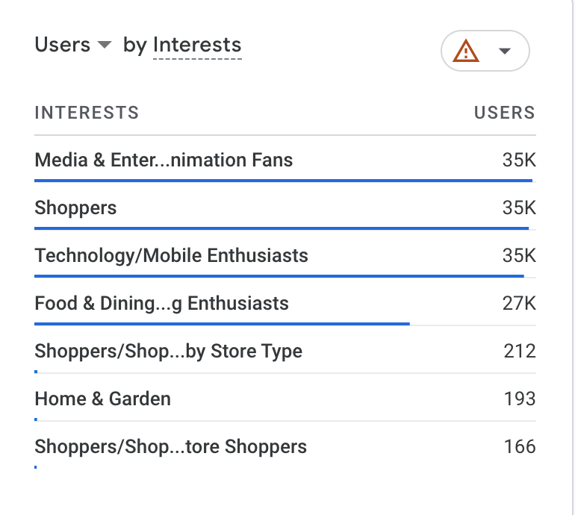
Who are the current Google Merchandise Store users?
There are more male users (61%) than female (39%) who show interests in Media & Entertainment & Animation fans, Shoppers, and Tech/Mobile enthusiasts

Slide 5
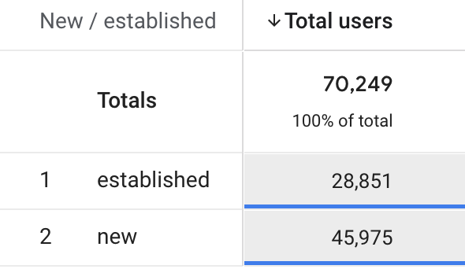
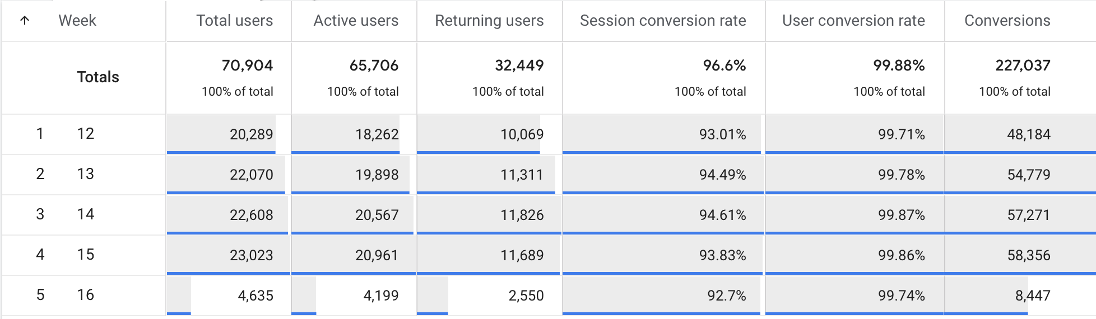
What behaviors do shoppers exhibit on the site?
Growth metrics: Session Duration, Returning Users, Active Users, Conversion Rate
Insights-
There are a total of 70K users using FloodIt app, 41% of them are established users while 65% of these users are new. Based on the month of available data, highest number of users (total & active) are in Week 15 with the user conversion rate of 99.86%.
However, Week 16 has the lowest numbers across all metrics including total users, active users, returning users, conversions and conversion rates.

Slide 6
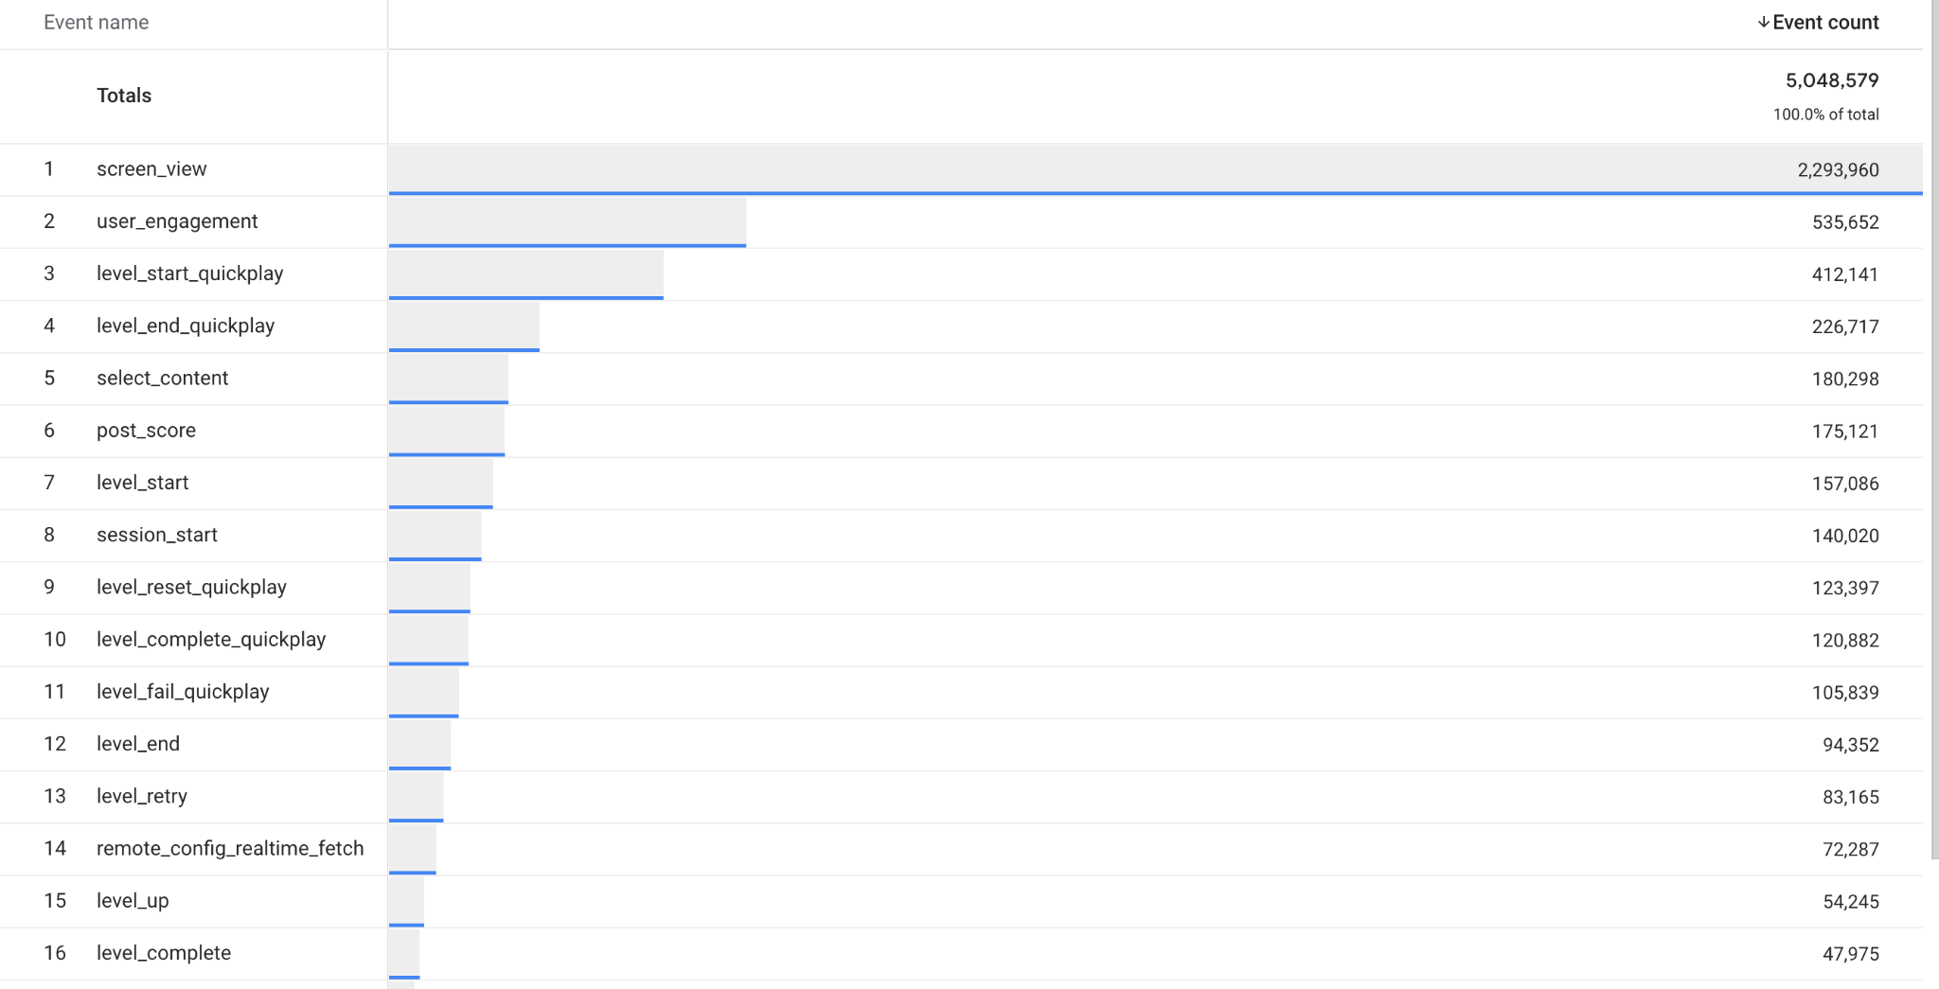
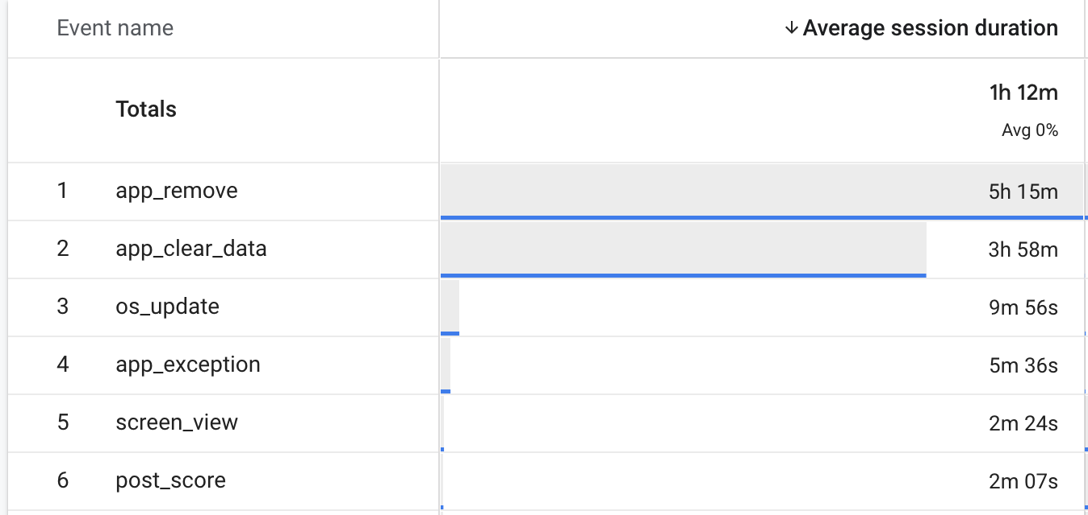
What behaviors do shoppers exhibit on the site?
Engagement metrics
Insights - the highest number of average session durations are seen in the app removal event and app clear data. Additionally, looking at the event count, we can see that even though user engagement makes up about 10% of event counts, we can also see that level up event and level complete event are really low, around 1%.

Slide 7
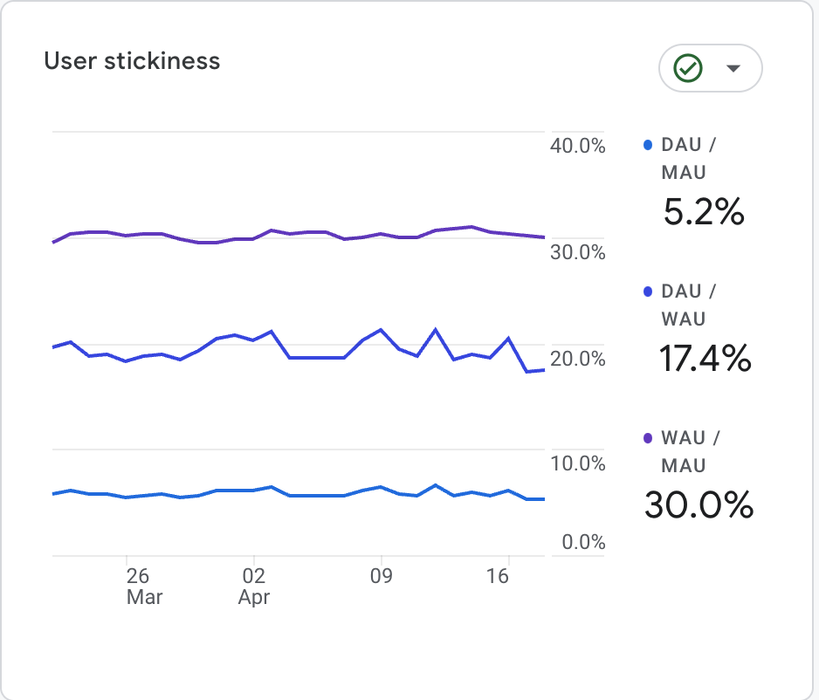
What behaviors do shoppers exhibit on the site?
Stickiness metrics: DAU, WAU, MAU, Stickiness Ratio
Insights-
Stickiness metrics are not as strong as we would like them to be. DAU/MAU ratio is 5%, DAU/WAU is 17% and WAU/MAU is 30% for a 4 week timeline.
Notes:
Stickiness Ratio: This metric is calculated by dividing DAU by MAU. It gives us insight into the percentage of monthly users who are active on a daily basis and helps us understand how loyal and engaged our user base is.
Daily Active Users (DAU): This metric measures the number of unique users who engage with the app on a daily basis. It helps us understand the number of users who are using the game regularly and gives us insight into the level of engagement and loyalty of our users.
Weekly Active Users (WAU): This metric measures the number of unique users who engage with the app on a weekly basis. It helps us understand the level of engagement and loyalty of our users over a longer period of time.
Monthly Active Users (MAU): This metric measures the number of unique users who engage with the app on a monthly basis. It helps us understand the overall size of our user base and how many users are returning to the app on a regular basis.
Retention Rate: This metric measures the percentage of users who return to the game after their first interaction. It helps us understand how compelling and engaging our game is and whether users are likely to continue using it over time.

Slide 8
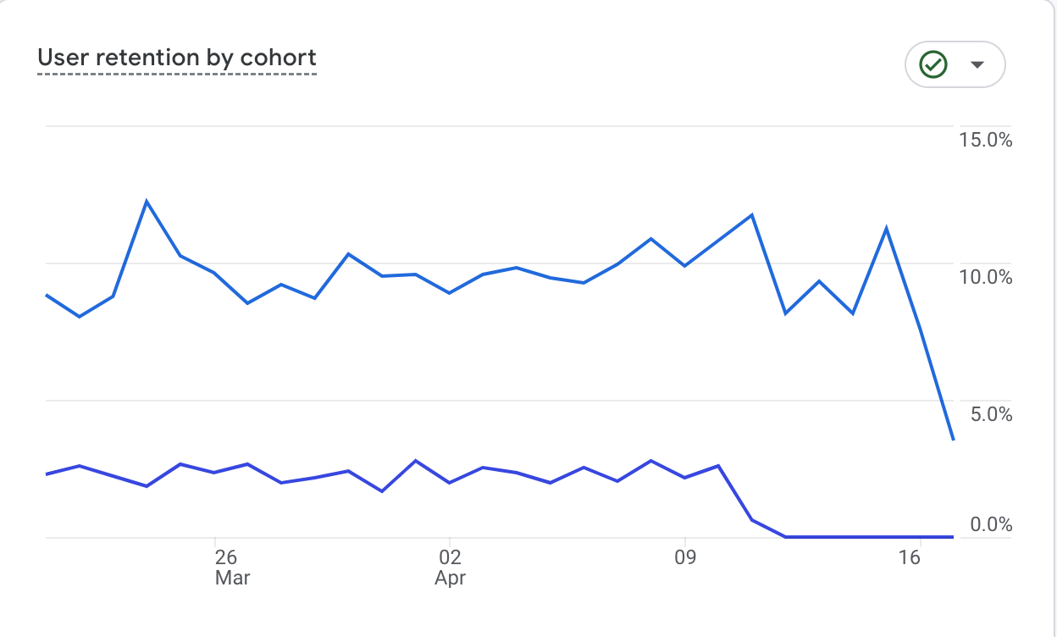
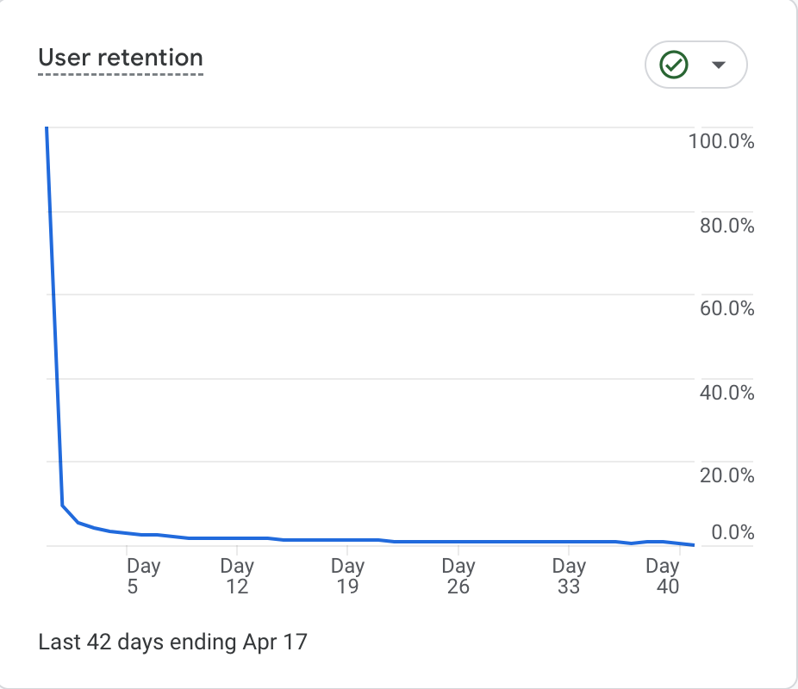
What behaviors do shoppers exhibit on the site?
Retention metrics:
Day 1
Insights-
Retention metrics are also shown to be weak. User retention by cohort drops significantly in the Day 7 of using the app. We exhibit 0% of engagement on April 16th. Other days retention is around 2% in Day 7 compared to Day 1 between 8%-12%.
Additionally, user retention drops gradually from Day 1 to Day 41. Day 1 exhibits the highest of 9% and then it continues to slowly drop till it reaches less than 1% on Day 41.
Day 7

Slide 9
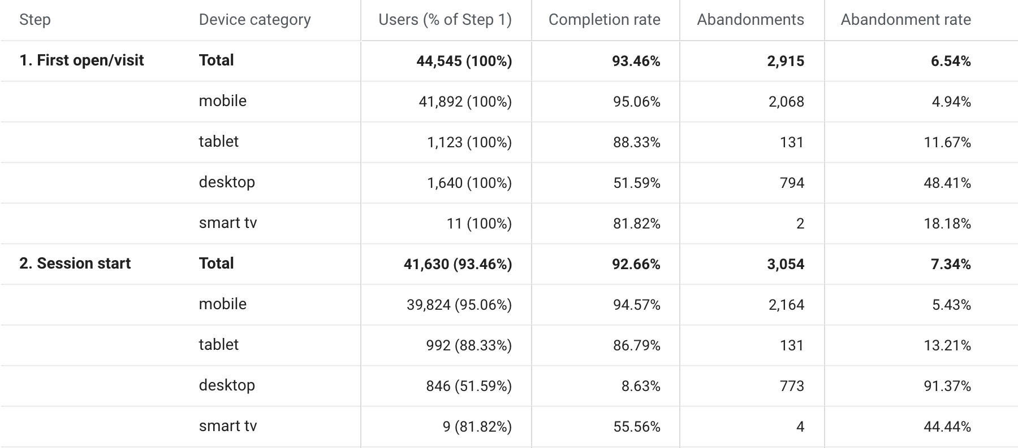
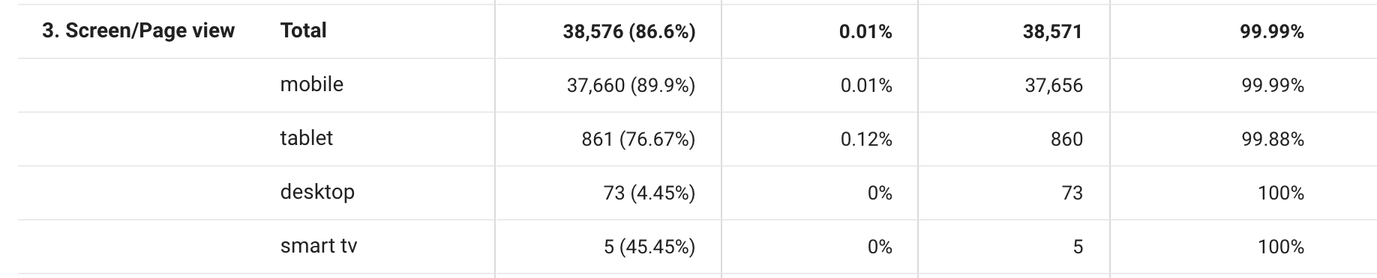
Are there different user segments that behave differently on the site?
If so, what are the key segments to examine for these segments? How do they differ?
Insights-
Highest % of users first visit the app on their mobile device, followed by desktop and tablet. And Highest completion rate is also shown in mobile followed by tablet. Even though we see users use desktop device to open the app, we can see the completion rate being the lowest of 51% in comparison to the rest of devices and abandonment rate the highest of 48%.
When looking at Session Start, Mobile has the highest users and completion rate, followed by tablet. The abandonment rate is really high on desktop (91%) followed by smart tv (44%).
Screen/Page View is dominated by mobile users (90%) with the lowest completion rate of 0.01% and highest abandonment rate 99.99%.

Slide 10
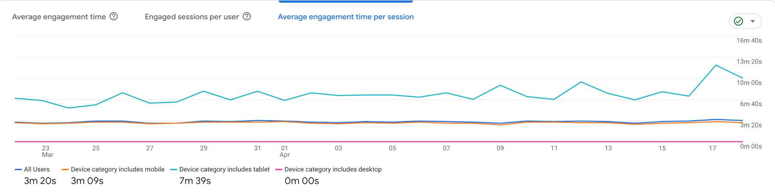
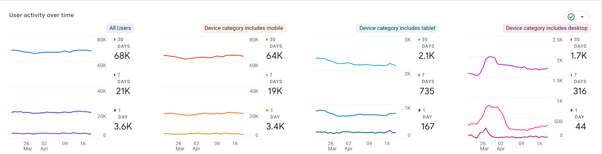
How have users and their behaviors changed over time?
Where do engagement issues exist?
Insights - As we already know that most of our users use the app on their mobile, but it seems that the highest number of engagement time per session is seen on the tablet of 7m 39s while on mobile its only 3m 09s.
The engagement issues exist on mobile and tablet, even though tablet has highest engagement. Tablet is only being used during first visits but not continues gaming sessions.

Slide 11
What KPIs do you recommend tracking to measure and assess the health of the app in the future?
Recommended KPIs-
Retention rate by cohort: This metric measures how many users are continuing to use the app over time, which gives us an indication of the app's overall stickiness and user satisfaction.
Daily active users (DAU) and Monthly active users (MAU): This metric measures the number of users who engage with the app on a daily and monthly basis. By tracking DAU and MAU, we can understand the app's overall popularity and identify trends in usage over time.
User acquisition: This metric measures the number of new users who download and install the app. It helps us understand the app's reach and growth potential.
Conversion rate: This metric measures the percentage of users who complete a desired action, such as making an in-app purchase. It helps us understand the effectiveness of our monetization strategy and identify opportunities for improvement.

Slide 12
What opportunities do you see to change the game to improve users’ gaming experience?
Improve the onboarding process: Based on the data, new user retention is low. Therefore, we need to evaluate our onboarding process and ensure that it is engaging and intuitive to encourage users to continue playing.
Enhance the gameplay: The low level up and level complete events suggest that users are not finding the gameplay to be engaging enough. We can explore opportunities to add new features, levels, and challenges to make the game more fun and rewarding for users.
Improve retention and stickiness: By improving the retention rate and stickiness of the app, we can create a more satisfying and enjoyable experience for users. We can explore opportunities to enhance the social and community features of the app and provide users with a more immersive and personalized experience.

Slide 13
What qualitative research do you propose to follow up on the data you analyzed?
User surveys: Conducting surveys with users can help us gather more detailed feedback on their experience with the app, including what they like and dislike about the app and what features they would like to see added or improved.
In-app feedback: We can add a feedback feature in the app to enable users to provide feedback on their experience, which can help us identify areas for improvement.
User testing: Conducting user testing sessions can help us gather more in-depth insights on how users are interacting with the app and identify any usability issues or areas for improvement.

Slide 14
Reflection Paper: What additional data do you wish you had?
Reflection Paper: What was the most challenging part of the analysis to complete? Why?
Additional data that could be helpful to have include user demographics such as income level, education, and occupation. These data can provide further insight into the interests and behaviors of users, which can help us tailor the app experience to better meet their needs.
The most challenging part of the analysis was identifying the key segments to examine and how they differ in their behavior on the app. It required a deep dive into the available data and analyzing multiple metrics to gain a comprehensive understanding of user behavior on different devices.

Slide 15
Reflection Paper: What other research or analysis would you want to supplement your findings?
Other analyses that would be interesting to complete include A/B testing of new features or changes to the app's design to understand the impact on user engagement and retention. Additionally, analyzing user reviews and feedback from app stores or social media can help identify common issues or areas for improvement.

Slide 16
Reflection Paper: What was the most interesting insight you uncovered?
Reflection Paper: How might you use this kind of analysis in your product management career?
The most interesting insight uncovered was the difference in engagement time per session on mobile and tablet devices. While tablet users have the highest engagement time, they only use the app during their first visit and not in continuing gaming sessions. This insight can help guide future development efforts to enhance the tablet experience and encourage users to return for more gaming sessions.
This type of analysis can be used in product management career in many ways, including identifying opportunities for product improvement, measuring product success, and guiding product development decisions. Analyzing user behavior and preferences is a crucial part of product management and using data-driven insights can help make informed decisions that result in a better product for the end-user.

